Slide 1
Classes and Objects in Java
Phil Tayco
San Jose City College
Slide version 1.1
Updated Apr. 20, 2021

Slide 2
Primitive Data Types
All variables are defined with a data type and variable name
int age = 21;
double gpa = 3.9;
Memory for age and gpa is instantly created and contents are initialized
The process is automatically done because the language already knows how to handle these simple data types
age
21
gpa
3.9

Slide 3
Complex Data Types
We can create separate variables that are each instances of an int data type (such as int age; or int option; etc.)
Many times, variables like age and gpa are used repeatedly in larger organizations of data
30 Students in a classroom, for example, will each have their own age and gpa
To manage this in a program, you’d need 30 different age and 30 different gpa variables to represent each student’s respective characteristics

Slide 4
Complex Data Types
We could look at age and gpa, though, and say that these are common characteristics to define what a type of Student could look like
The key word in that sentence is type – notice that int and double are types of data, and they’re simple and known by Java
A Student can also be considered a type of data, but they’re more complex and have to be defined for Java
We can design that by saying that a Student data type is such that each Student has an age, has a gpa, and maybe other characteristics (like name and gender)
Defining such data types is the beginning of learning classes and objects in Java

Slide 5
Complex Data Types
How do we tell Java what “a Student looks like”?
Think of every Student that you may want to model in a program. Every Student for our particular design could have:
  First name
  Last name
  Age
  Gpa
  ID
Each one of these elements of a Student we’re going to call a “property” (also called an “attribute”)

Slide 6
Complex Data Types
These properties make up the template for defining the data type for a Student
In the simple world, we could create a variable with “int age;” and assign it a value of 21
Similarly, we can create a variable with “Student me;”
We can’t assign it a simple value of 21, but we can assign values to each of its properties
This means Student’s properties are like variables grouped together within the overall Student variable (“me”)
As such, each property is defined like a variable

Slide 7
Complex Data Types
Create a new project in Java
In the “Introduction To GUIs Part One” slide deck, you were introduced to creating separate class files in your project like the “TextFieldFrame” (see slides 14-16 of that Powerpoint)
You will do the same thing here by creating a new class file in the project.
Name this class “Student”
You should see a new file created with very simple code created as “public class Student”

Slide 8
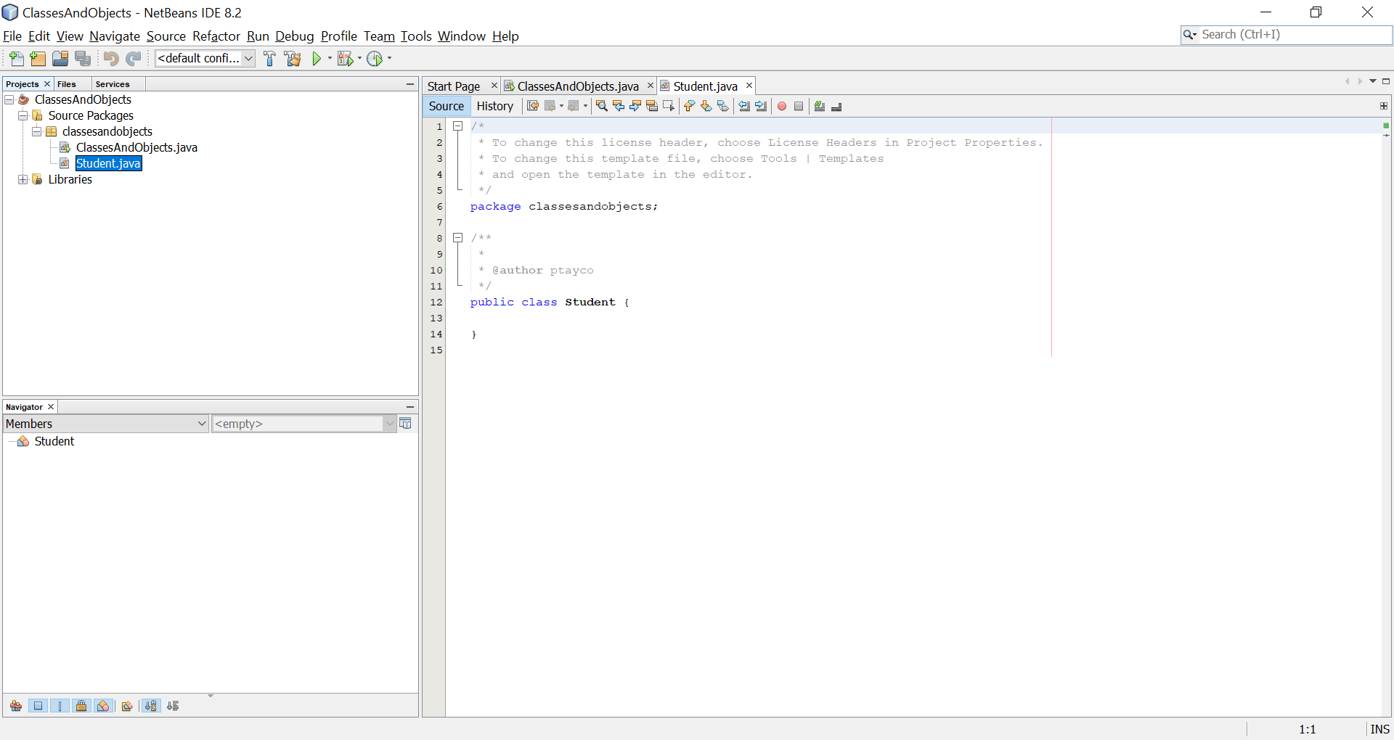
Complex Data Types

Slide 9
Complex Data Types
Now fill in the following code in the new file
public class Student
{
  public String firstName;
  public String lastName;
  public int age;
  public int id;
  public double gpa;
}
This code defines the properties of a Student data type
Think of it like defining an int but instead of intending it to store one integer value, a Student will store a String firstName value, a String lastName, an int age, etc.

Slide 10
Complex Data Types
Now go to the other file and in the “main” function, enter the code below
This code is creating a Student variable called me and assigning values to different properties of that me Student variable
public static void main(String[] args)
{
Student me = new Student();
me.id = 1234;
me.age = 21;
me.firstName = “Phil”;
}
me
firstName
“Phil”
lastName
id
1234
age
21
gpa

Slide 11
Complex Data Types
Once you have values for “me”’s properties, you can use them as you would normal variables:
public static void main(String[] args)
{
Student me = new Student();
me.id = 1234;
me.age = 21;
me.firstName = “Phil”;
System.out.println(me.firstName);
if (me.age >= 21)
System.out.println(me.firstName + “ is an adult”);
}

Slide 12
Complex Data Types
While the code appears a little different, the same process and capabilities can be applied as with creating variables of simple data types
With simple data types, you can define as many different variables defined with primitive data types as memory allows (int x, int y, int z, etc.)
Similarly, you can define as many different variables with complex data types (Student me, Student you, Student her, etc.)
Complex data types are referred to as “classes” (i.e. Student is a class)
Variables whose data type is a class is called an “object” (variable “me” is an object)
Objects are often referred to as “instances” of a class

Slide 13
Prog Exercise 8 Part 1
Create a class that models a simple Car
For your Car class, create 5 properties that will utilize at least 1 String, 1 int and 1 double. The properties are:
  Make (e.g. “Toyota”)
  Model (e.g. “Corolla”)
  Year (e.g. 2016)
  Price (e.g. 15000.99)
  Some other property of your choosing
Next, write code in main that creates 2 Car objects and assigns values to each one’s properties
You can hard code the values in the code and display them on the screen (you do not have to get information from the user) – the purpose of this exercise is to get you used to creating a class and multiple objects of that class

Slide 14
Accessing Properties
When a class is designed with the data members public, a binding occurs between the code creating the object of that class and the class’ design
Class example:
public class Student
{
  public String firstName;
  public String lastName;
  public int age;
  public int id;
  public double gpa;
}

Slide 15
Accessing Properties
Using that class, objects in other areas can set property values directly:
  public static void main(String[] args)
  {
  …
  me.firstName = “John”;
  me.id = 123;
  }
This makes the object and class code somewhat dependent on each other
Changes in code on the use of the object are ok as they won’t affect the class code design
Here we see we can change the firstName or id of the me object any time
Changes to the design, though, are different

Slide 16
Accessing Properties
Go to your Student class code and change the properties
public class Student
{
  public String first_name;
  public String lastName;
  public int age;
  public String id;
  public double gpa;
}
You’ll now see errors on the main program because it has code dependent on the first design requiring main to make changes:
  me.firstName has to change to me.first_name
  me.id = 123 has to change to me.id = “123”

Slide 17
Accessing Properties
In small amounts of code, this can be manageable, but as programs get larger and object use increases, any change in class code design has more downstream effects
Class properties tend to be highly used – programs are fundamentally designed to manipulate the variable values and make logical decisions from them
It is also hard to predict what complex programs actually need as they evolve (i.e. class designs change often)
Classes are also supposed to be stand-alone. New programs using the class may have different needs than as the class originally was designed
As requirements change, data types used will evolve

Slide 18
Strong Encapsulation
Because class properties have such high usage and evolution, another approach is to hide that information from other programs
Change your Student class code now as follows:
public class Student
{
  private String firstName;
  private String lastName;
  private int age;
  private int id;
  private double gpa;
}
Making these properties private now means any object created as type Student cannot directly access the properties (example.id = 123 would result in a compile error)

Slide 19
Strong Encapsulation
How are property values manipulated if they are marked as private? Something else has to be marked as public…
To this point, our classes have properties that manage values
In addition, we can also add functions to the class design
These allow us to perform functions that can be done on a specific object:
  Set the Student’s name
  Check if the Student has a passing grade
  Determine if the Student is an adult based on their age
These functions are known as “behaviors” or “methods” and they define what we can do to or with an object of that data type

Slide 20
Class Methods
We’ve already seen code that define actions such as “calculateArea” or “println”
These actions are defined in the form of a function. Recall that a function is defined with 3 parts: function name, return type and input parameters
public double calculateArea(double length, double width)
{
return length * width;
}
This function is defined with the name “calculateArea”, a return type of “double” and has 2 input parameters that are each “double” data types

Slide 21
Class Methods
Within the function contains the code for performing the overall action it is intended to define
We learned that such code is designed to be stand-alone and reusable
A method defined for a class acts the same way – it’s reusable code
When invoked, that function is applied to the specific object that called it
For example, since the properties of the Student class are now marked as private, we can define functions that allow us to “set the first name of a Student object”

Slide 22
Class Methods
public class Student
{
  private String firstName;
  public void setFirstName(String f)
  {
  firstName = f;
  }
}
In this example, the method signature is “setFirstName”. It takes a String as an input parameter and returns nothing (return type is void)
Within the function, “f” is a local String variable initialized by the input value where the function was called
The goal of this method is to set the firstName property to a given value (stored in f)

Slide 23
Class Methods
Typical questions arise from this approach
How is this function called?
Where and how is “firstName” used?
Remember that these functions live within the context of a class
A class is used when an object is created of its type (such as “Student me = new Student();”
Once an object is created, anything defined as public within the class design is usable and will apply to that specific object

Slide 24
Class Methods
Go back to main and change your code:
  Student me = new Student();
  me.setFirstName(“John”);
This line of code is calling the setFirstName function defined in the Student class
It was invoked from the “me” object so we interpret this as calling setFirstName for “me”
Notice that the function is the only thing public so far defined in Student
Since the Student properties are private, this function gives us a method to use those properties for any object (in this case, set it)

Slide 25
Class Methods
To go into further detail, when the method is called, “John” comes in as an input value that will be assigned to the “f” variable in the setFirstName function
  public void setFirstName(String f)
  {
  firstName = f;
  }
The only line of code in the method is “firstName = f;”. Where is firstName defined?
Remember that this function and the properties are all defined within the class
This means the setFirstName function knows how the firstName property is defined

Slide 26
Class Methods
public class Student
{
  private String firstName;
  public void setFirstName(String f)
  {
  firstName = f;
  }
}
Now notice that we treat firstName like a variable (we are assigning it a value)
Multiple objects, though, can be created from the Student class
If that’s the case, what firstName is getting this value of “John” in this instance?

Slide 27
Class Methods
Remember that this function was called from “me.setFirstName(“John”);”
Because setFirstName was invoked from the “me” object, the firstName property that is getting the value of “John” is the firstName property for the Student instance of “me”
By calling the function setFirstName(“John”):
  “John” is used in the function (through f)
  f is assigned to the variable firstName
  firstName represents the property of the me object (because we called it with “me.setFirstName(…”)
  “me”’s firstName property now has the value “John”

Slide 28
Class Methods
This approach can be used with all class properties. “setGpa” is defined as follows:
  public void setGpa(double g)
  {
  gpa = g;
  }
Some things to note:
  “gpa” property name is part of the function name “setGpa” – what do you think the function name should be for updating the id or lastName properties?
  The input parameter type is “double” which matches the gpa property data type definition. What would the input parameter types be for id and lastName?
Notice the return type for all of these are “void”

Slide 29
Class Methods
Remember that “void” represents that no value will be returned from this function
This makes sense for the purpose of these “set” functions as they simply take the given value and assign it to a specific property
The return value is designed to be used by the calling function, but in these cases, there’s likely nothing needed from the “set” functions when they are called
This doesn’t mean all “set” functions have to return void, they can return int or boolean if we desire and may be more applicable later

Slide 30
Class Methods
If we create multiple objects, these methods can now be used within the context of each object:
  Student one = new Student();
  Student two = new Student();
  one.setFirstName(“Susan”);
  two.setFirstName(“Alex”);
One and two are physically two separate objects with their own property values
Both are using the same code instructions to set their individual firstName properties respectively
These particular methods are frequently used and commonly referred to as “setters” or “mutators” – they are functions designed to change object property values

Slide 31
Class Methods
Could you create set methods that change more than one property at a time? Yes!
public void setName(String f, String l)
{
firstName = f;
lastName = l;
}
This implies more flexibility and functional capability you can design when creating setters for your class
  setFirstName, setLastName, and setName can all exist
  The users of the class can decide which methods they want to use
Setters are needed for changing object property values. What about when we need to view the data?

Slide 32
Accessing Data
Previously, we could look at an object’s property value at any time directly from main:
  System.out.println(me.firstName);
However, the firstName property is now private
We need another way to retrieve that value
Put another way, we need another “method” that is designed to “return” the firstName value to us
This leads to designing another function. Based on the information here, what would the method signature for seeing the object’s firstName value?

Slide 33
Accessing Data
Add the following method to your Student class:
public String getFirstName()
{
return firstName;
}
The name of this function (which also states its purpose) is appropriately entitled “getFirstName”
The return type is a String meaning that when the function is called, we will get what represents the firstName of the Student object as a String
Like “setters”, these functions are called “getters” whose purpose is to retrieve a specific property value for a given object
Now you can obtain property values in main

Slide 34
Accessing Data
In main:
System.out.println(me.getFirstName());
Inside println, we need to provide a String value
“me.getFirstName()” is calling the getFirstName getter function
This will return the firstName property value of me as a String
That value will be provided to println to show on the screen
A similar approach can be done with other getters from main
Notice that there are no input parameters for the getter functions…

Slide 35
Accessing Data
Just like with the set methods, these get methods are designed to be used for each class property
Because the value coming back is through a return value of a function, the get methods are only designed to return a property value
There are usually no input parameters with get methods because their job is to return existing (and known) information. No new information from the code calling the method is needed to perform this action
The return type in this example is a String which matches the definition of firstName in the class
This pattern is often the case with these methods
  If you have a property “private <data type> <name>;”
  Setter: public void set<name> (<data type> variable)
  Getter: public <data type> get<name>()

Slide 36
Setters and Getters
You typically see a get and a set function for each property (a class with 4 properties will usually have 4 setters and 4 getters)
Their function signatures usually follow a pattern based on the property name and its data type
Some classes may not want to have certain setters/getters defined – this will depend on the class designer’s intent of use
Any number of additional setter functions can occur (like setName)
Getters, however, can only return one value at a time for a function
  Note: you could still define a “public String getName()” getter which will return firstName and lastName as one String, but in general multiple property values are harder to return than setting multiple properties at once

Slide 37
Changing Design
Why go through the of creating set and get methods when making the properties public seems so much easier?
Recall the dependency between the modules and when class code changes – the change impacted the code in main in our previous examples
Now, if we wanted to, we can change a property name or a property data type, without impacting main because that code is marked as private

Slide 38
Changing Design
public class Student
{
  private String first_name;
  public void setFirstName(String f)
  {
  first_name = f;
  }
}
We changed the property from firstName to first_name
Because of that, we also had to change its use in the setFirstName method
Important: the main program still calls the method with me.setFirstName(“John”); - this code does not change and still runs!

Slide 39
Changing Design
This puts in a foundation such that your class code can now change with less impact to other programs using it
This also emphasizes the importance of a function signature – because it is public (it is the interface for the application programmer), once it is in use, great care must be taken if you decide to change it
This also implies the importance of trying to define the signature well before releasing for use
Once established, code changes within the methods and anything marked private can be done within the class code file itself

Slide 40
Prog Exercise 8 Part 2
Update your Car class so that all the properties are now private
Add the appropriate set/get methods to your class
Update the main program to have each Car object call all set/get functions you created to test your code
If you’re new to classes and objects and Java, I recommend doing Exercise 8 part 1 first and ensure it is working – you don’t have to submit it to me unless you want me to check your code structure and/or have questions
If you want to go directly to part 2, that is fine. This code is what you must submit for grading on the exercise

